Slide 1
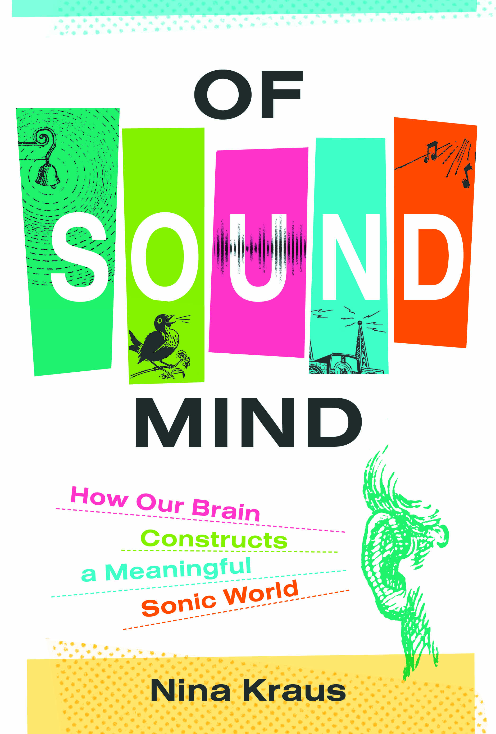
NOISE THERMOMETER
pain
hearing damage in 8 sec
— 120 dB Ambulance siren
— 110 dB Car Horn
— 100 dB Jackhammer
— 90 dB Gas lawn mower
— 80 dB Garbage disposal
— 70 dB Vacuum cleaner
— 60 dB Air conditioner
— 50 dB Refrigerator
— 40 dB Library
— 30 dB Quiet rural area
— 20 dB Rustling leaves
— 10 dB Breathing
— 0 dB Softest sound a person can hear
… 1 min
Bad for ear
… 15 min
… 2 hr
Bad for brain!
… 8 hr
Nina Kraus
https://brainvolts.northwestern.edu/
Notes:
Exposure to loud noise is a recognized problem and a source of major health issues. Audiology students will learn about this in great detail and further info is provided below. However, in this class we will be focusing on the less obvious effects of noise on communication and underlying biological systems.
Sources of noise:
Machinery, industrial noise
Other occupations involving high noise exposure (see below)
Musicians
Military personnel
Playing music too loud through ear phones
Increasing reports of hearing loss in adolescents due to personal music players
Don’t yet have the data to know what the long-term effects are
Exposure to loud sounds without adequate protection (guns, fireworks, loud concerts)
Effects of noise exposure in various professions:
Musicians:
Schmidt JH, Pedersen ER, Juhl PM, et al. Sound exposure of symphony orchestra musicians. Ann Occup Hyg. 2011;55:893–905. [PubMed]
Jansen EJM, Helleman HW, Dreschler WA, de Laat JA. Noise induced hearing loss and other hearing complaints among musicians of symphony orchestras. Int Arch Occup Environ Health. 2009;82:153–64. [PubMed]
Military:
Muhr P, Rosenhall U. The influence of military service on auditory health and the efficacy of a Hearing Conservation Program. Noise Health. 2011;13:320–27. [PubMed]
Yankaskas K. Prelude: noise-induced tinnitus and hearing loss in the military. Hear Res. 2013;295:3–8. [PubMed]
Personal music player:
Scientific Committee on Emerging and Newly Identified Health Risks (SCENIHR) of the European Commission. [accessed July 11, 2013];Potential health risks of exposure to noise from personal music players and mobile phones including a music playing function. 2008 http://ec.europa.eu/health/ph_risk/committees/04_scenihr/docs/scenihr_o_017.pdf.
360 million people globally with disabling HL
38 million in US with significant hearing loss in at least one ear
Most common occupational disease in the USA
22 million US workers are exposed to hazardous noise levels at work
Estimated $242 million annually spent on compensation for hearing loss disability
Clinical trials in progress for drugs to treat hearing loss, however prevention is (currently) the only way to preserve hearing
OSHA's permissible exposure limit (PEL) is 90 dBA for an 8 hour day.
The National Institute for Occupational Safety and Health (NIOSH) recommends keeping noise exposure below 85 dBA for eight hours, based on updated research.
Still, ignores potential impact of long-term exposure to moderate noise
Basner, M., Babisch, W., Davis, A., Brink, M., Clark, C., Janssen, S., & Stansfeld, S. (2014). Auditory and non-auditory effects of noise on health. The Lancet, 383(9925), 1325-1332.

